Slide 1
Day 1: R for Open & Reproducible Science
David Souto
School of Psychology and Vision Sciences
Notes:
Short intro on the importance of open and reproducible science - organization of the workshop
We are going to mention levels … as a way to cater for people at different stages / who have different needs. Level's 2-3 go beyond what we can cover here. You could attempt exercises at this level if you have time left, but the idea is that Level 1 provides you with a basic and perfectly serviceable understanding of the topic for our purpose.
Introducing the RStudio interface (20')
<!-- TBD: could produce a video and live-code; can show setwd() tips with ".." and ".", at times opening a file does not set up the working directory correctly,
can do getwd() to figure out where you are and use ".." to go back one or "./03_session" for instance to go one folder down-->

Slide 2

Instructors team
David Souto, Lecturer, Open Science Team Lead
Samantha Tyler, Postdoctoral researcher, UoL & Bham
Anna Nowakowska, Early Career Fellow, UoL
Tamara Gheorghes, Lecturer, UoL
Mahmoud Elsherif, Postdoctoral researcher, UoL
Acknowledgements
Midlands integrative biosciences training partnership
Improving Research Community Builder Award (University of Cambridge)
to Samantha Tyler, Faye Balcombe, Mahmoud Elsherif, Callum Hunt, Milena Rota

Slide 3
Why this workshop?
Provide researchers with basic tools to tackle challenges to reproducible science:
Knowledge
Statistical reasoning
Practical skill
Notes:
Four years of promoting OS within department in one intense workshop told us we need a focused workshop rather than repeating things across the year

Slide 4
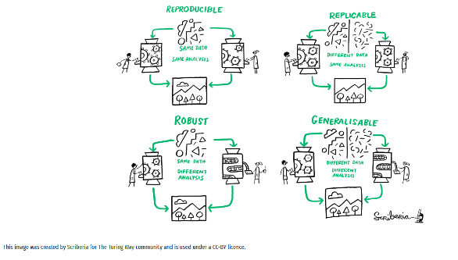
Reproducible Science
Definitions of reproducibility / replicability / generalizability (not universally agreed upon): https://osf.io/cgdsn / many analyst
Notes:
“Many analyst projects (Silberzahn et al., 2018), not limited to psychology only- economics (Huntington-Klein et al., 2025), biology (Gould et al., 2025), linguistics (Coretta et al., 2024)“

Slide 5
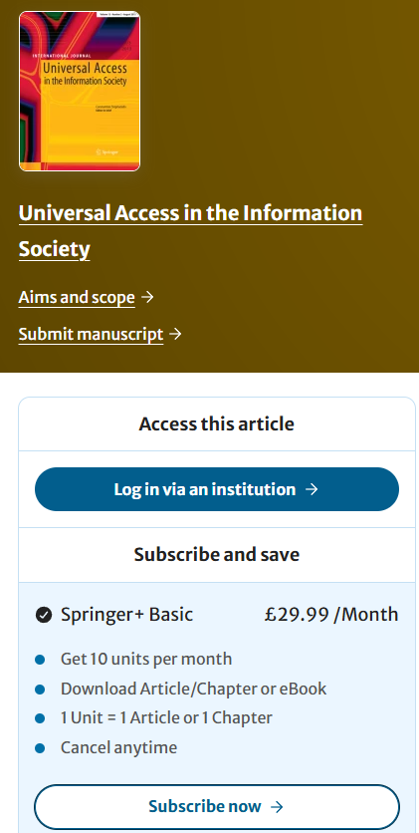
Universal access to research

Slide 6
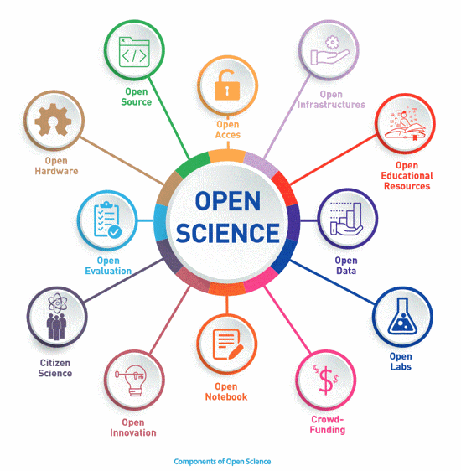
Open Science / Scholarship

Slide 7
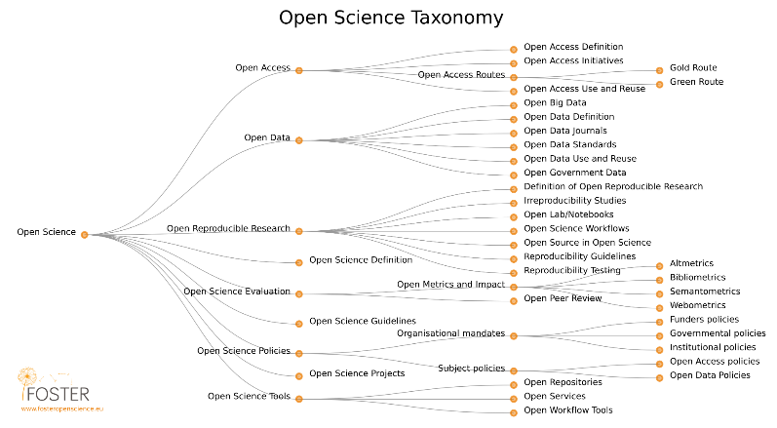
Wide implications
Notes:
We are focusing on the third brank

Slide 8
Access to outputs, data and process
Peer review
publication
Post-print
Private code & data
Pre-registration
Pre-print
Peer-review
Post-print
Publication
Public code and data
Universally
accessible
Universally
accessible

Slide 9
Workshop program: Day 1
Session 1:
Session 2:
Session 3:

Slide 10
Workshop program: Day 2
Session 1:
Session 2:
Session 3:

Slide 11
Workshop program: Day 3
Session 1:
Session 2:
Session 3:

Slide 12
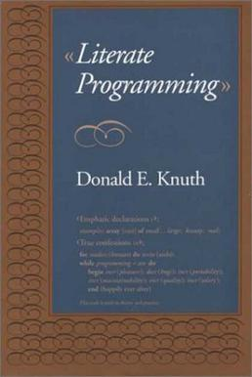
Literate programming
[Wikipedia example of lit prog]
Notes:
We are going to do this from the get go; the medium is the message here
<!-- A 40 year old concept put forth by another giant of computing - write code to be understood by humans not to suit the constraints of the machine; & switching betwee the visual/source options in RStudio; could be a live-code video as well, as it will make sense to use this for exercises-->

Slide 13
How to interact with Worksheets
Live demo
Recorded here
Notes:
Source vs Visual ! Chunks … Execute code. Run exercises. Try things. Talk to your neighbours!

Slide 14
Levels
Level 1: What you need to know
Level 2: Desirable, not essential
Level 3: Maybe useful to some people

Slide 15
The R Studio interface
Live demo
Recorded here
[interface]
Notes:
Different windows

Slide 16
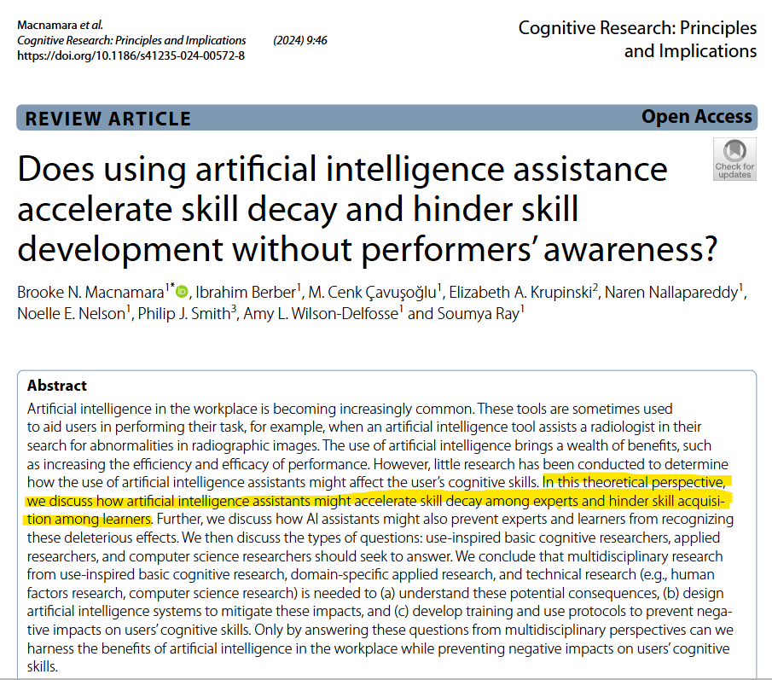
Use of AI
Productivity: AI can dramatically boost your coding productivity.
Learning: over-reliance on AI may lead to cognitive skill decay
Ethical Considerations: reliability, plagiarism, bias, environmental impact
Notes:
Very tangible risk of letting AI do the thinking for you

Slide 17
Session 1
Worksheets
Ex1.1 (XX’) -
Ex1.2 (XX’) -
Ex1.3 (XX’) -

Slide 18
Session 2
Worksheets
Ex2.1 (XX’) -
Ex2.2 (XX’) -
Ex2.3 (XX’) -

Slide 19
Session 3
Worksheets
Ex3.1 (XX’) -
Ex3.2 (XX’) -
Ex3.3 (XX’) -

